Slide 1
R&D / NLP PROTOTYPE
Recruiter–Candidate Call Analytics
Automated checklist verification and speech-pattern signals of call quality
01
01
01
01
Portfolio project · Python · Google Colab
Notes:
Open the portfolio project: an R&D notebook analyzing recruiter-candidate calls.

Slide 2
01 — OVERVIEW
Did the recruiter cover the required checklist?
The notebook analyzes diarized recruiter–candidate phone calls: it checks whether a required set of topics was covered, computes a compliance score against that checklist, and explores speech-pattern signals that may correlate with call quality.
Greeting
Citizenship
Age
Health
Salary
Paperwork
Notes:
State the project goal: automated checklist verification and compliance scoring.

Slide 3
02 — DATA
From transcribed CSV to per-utterance rows
1
CSV export of calls: the transcription field holds a JSON payload of diarized, timestamped utterances with emotion tags.
2
json_normalize + explode — the nested list of utterances is flattened: one dataframe row per utterance.
3
A second normalize + concat pass expands nested result fields into flat columns.
4
Split by spk — separate subsets for the recruiter (spk == 0) and the candidate (spk == 1).
Notes:
Show how raw CSV with JSON becomes a per-utterance dataframe.

Slide 4
03 — TOOLSET
Technology Stack
COMPONENT
TECHNOLOGY
PURPOSE
Environment
Python 3, Google Colab
Notebook development and execution
Data
pandas, numpy, json
Tabular processing, JSON parsing
Tokenization
NLTK (punkt, stopwords)
Tokens, noise reduction
Lemmatization / stemming
pymorphy3, SnowballStemmer, custom Porter (RU)
Normal and root word form
Keyword search
re (regular expressions)
Rule-based topic detection
Statistics
phik
Correlation across mixed-type features
Visualization
matplotlib, seaborn, plotly, wordcloud
Charts, heatmaps, word clouds
Notes:
The project's technology stack as a table.

Slide 5
04 — CLASSIFICATION
A checklist compliance score
0–10
0–10
0–10
0–10
CHECKLIST CATEGORY DISTRIBUTION
Greeting
A keyword/regex classifier tags each recruiter utterance with a checklist category. The score equals the share of on-topic utterances out of all utterances.
Salary
Paperwork
Age
Citizenship
Health
Illustrative mockup · normalized histogram (Plotly)
Notes:
Rule-based classifier and the 0-10 compliance score; show histogram.

Slide 6
05 — GENERALIZATION
From one fixed checklist to any custom text
The rule-based classifier only works for one fixed checklist. The generalized engine turns a one-off script into a reusable scoring approach.
Checklist text free-form
→
Tokens + lemmas NLTK, pymorphy3
→
Keyword stems SnowballStemmer
→
0–10 score for any checklist
Notes:
Explain how a fixed checklist becomes a generalized keyword-based engine.

Slide 7
06 — PREPROCESSING
A Single Reusable Preprocessing Function
01
Lowercasing and Russian ё → е normalization
02
Regex cleanup: HTML tags, punctuation and ellipses, repeated whitespace, encoding artifacts
03
Tokenizing utterances into words
04
Lemmatization — pymorphy3 and NLTK WordNetLemmatizer
05
Filtering stopwords and non-alphabetic tokens
Notes:
The unified text preprocessing function.

Slide 8
07 — EXPLORATORY ANALYSIS
Who Talks, and How
Talk-time ratio
Recruiter part-of-speech profile
Recruiter 60%
Candidate 40%
Hypothesis: healthy calls fall near a target ratio close to 60/40.
Illustrative mockup
Verbs
Nouns
Adj.
Adverbs
Hypothesis: a higher verb ratio correlates with more persuasive, active speech.
Notes:
Talk-time ratio and part-of-speech usage.

Slide 9
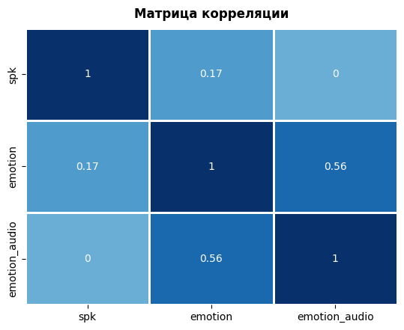
08 — EXPLORATORY ANALYSIS
Do Text and Audio Emotion Agree?
A phik correlation matrix between speaker, text-derived emotion, and audio-derived emotion tests whether the two signals agree and whether either correlates with speaker role.
Notebook output · phik correlation
Notes:
Emotion correlation via a phik matrix.

Slide 10
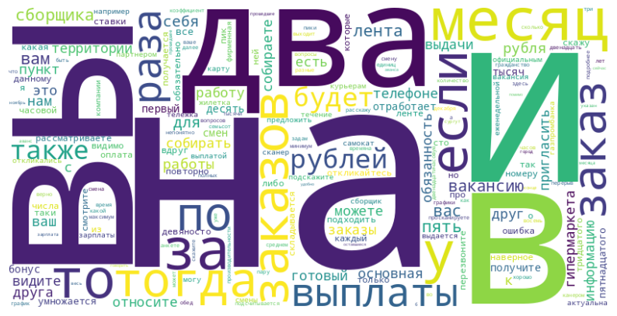
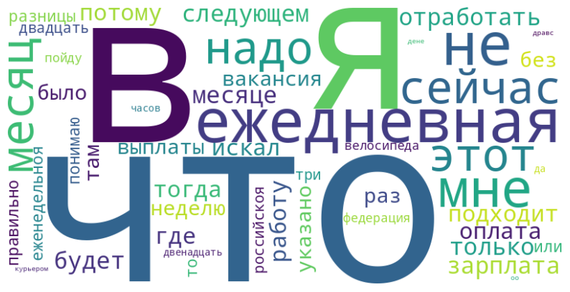
09 — EXPLORATORY ANALYSIS
Dominant Vocabulary, by Role
Recruiter
Candidate
Notebook output · wordcloud by utterance
Notes:
Dominant vocabulary for recruiter vs. candidate.

Slide 11
10 — SCOPE
An Exploratory Prototype, Not a Production System
11
11
11
11
The notebook demonstrates a methodology: rule-based and keyword-based NLP for Russian text, a custom call-quality scoring metric, statistical correlation analysis, and data visualization.
All company-, candidate-, and vacancy-specific details have been generalized or omitted — only the technical methodology is documented.
Notes:
Closing slide: framing as a prototype, scope of what's shown.

